Slide 1
Oaxaxa de Juárez, Oax. Abril 28, 2017.
Annual Report
Guardarenas México Program
Points of monitoring:
A. Bahía de la Costa Chica de Oaxaca (BACOCHO)
Sitio B. Playa Coral

Slide 2
Content 1. Annual chronology 2. Components implemented 3. Monitoring results 4. Statistics of participation

Slide 3
1. Annual chronology
A
Prior management activities: NOV-DIC 215/FEB-MAR 2016
B
Training –Sandwatch Methodology: ABR 2016
C
Monitoring: FEB 2016 - ABR 2017
Actually, we continue working on management activities to accompany the group in Pueto Escondido and working with a new group in Puerto Ángel.
1-1

Slide 4
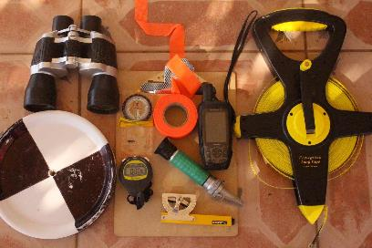
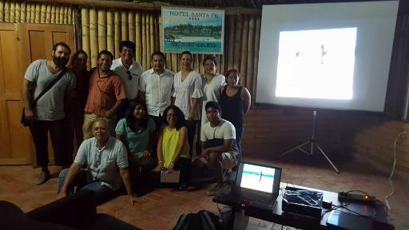
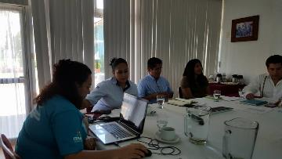
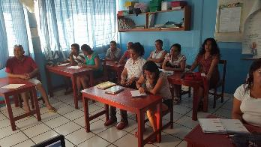
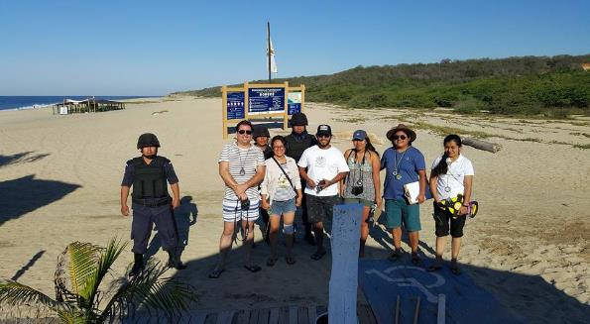
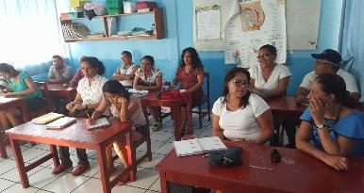
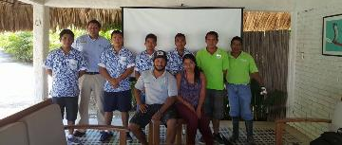
Management activities: NOV-DIC 215 / FEB-MAR 2016
A
1-2

Slide 5
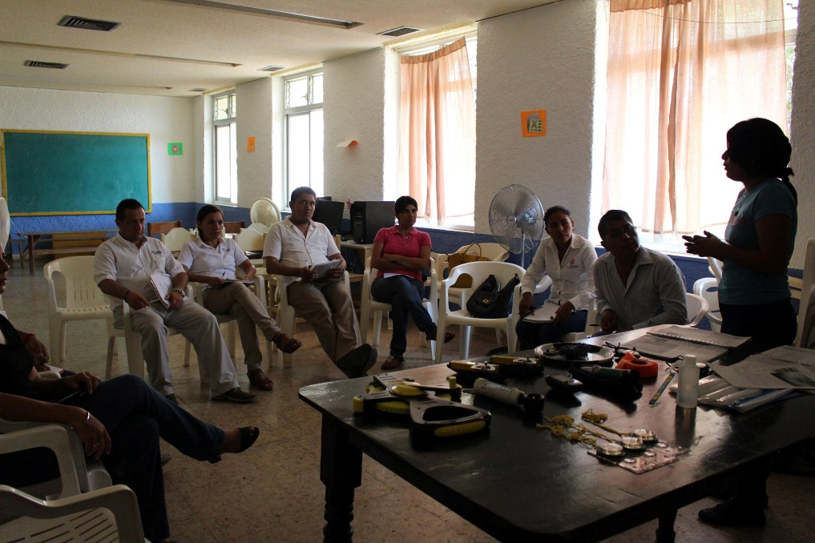
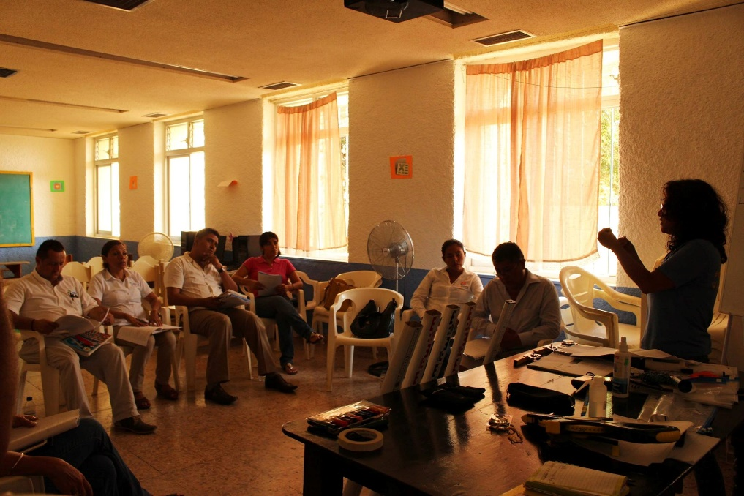
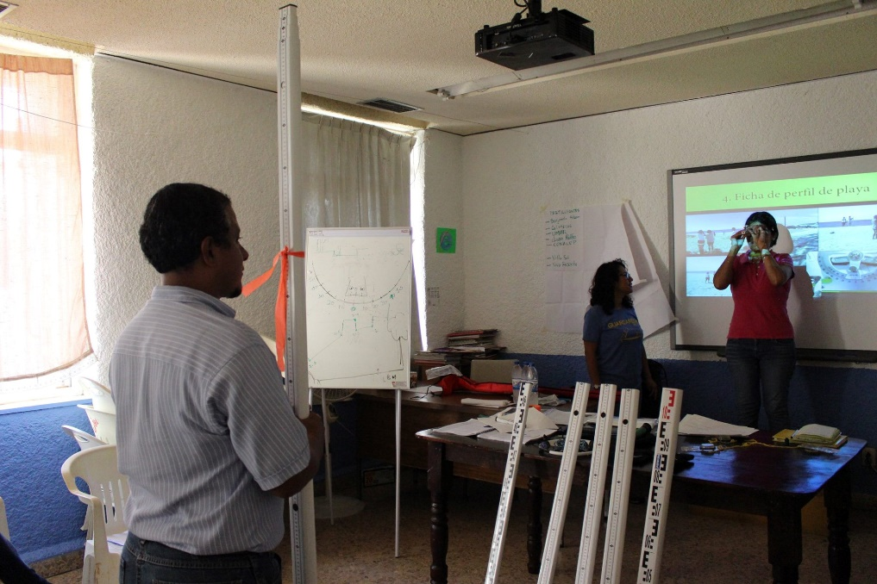
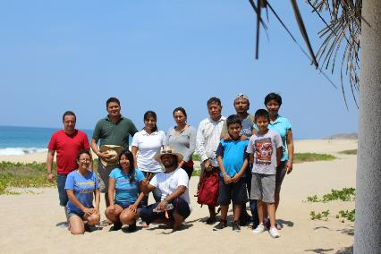
B
Training –Sandwatch Methodology: ABR 2016
1-3

Slide 6
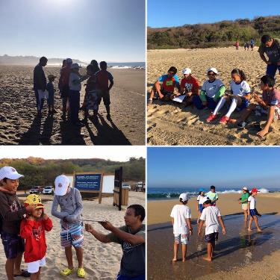
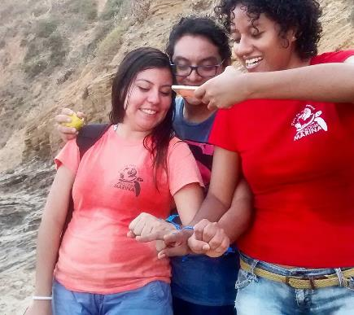
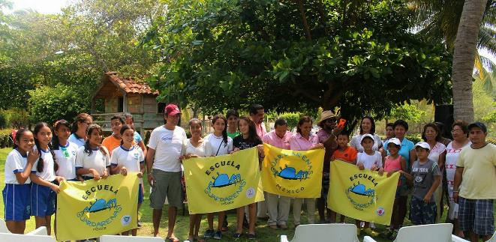
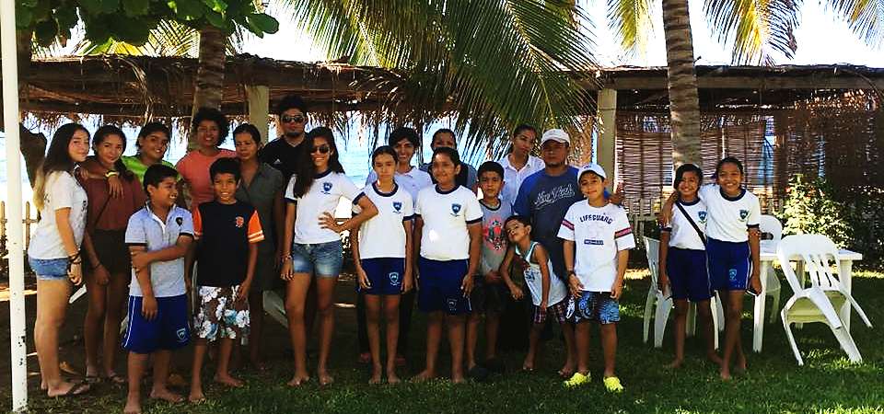
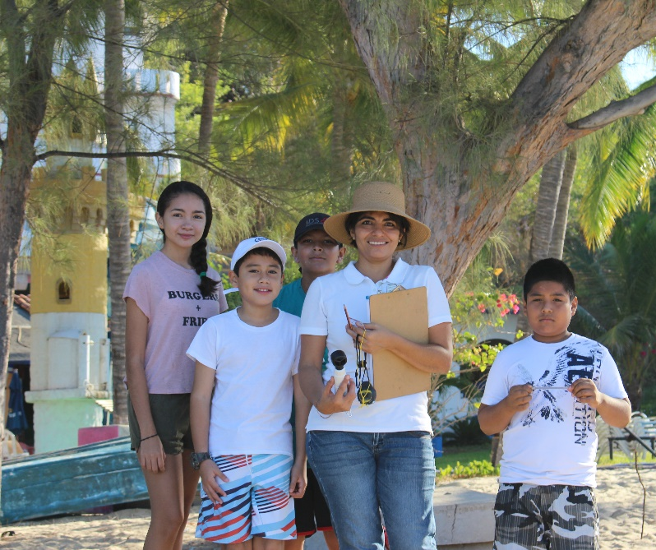
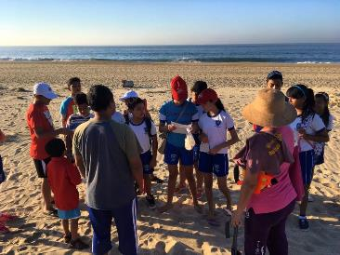
C
Monitoring : MAY 2016 - FEB 2017
1-4

Slide 7
M.
A.
S.
T.
Sandwatch volunteers- Students of Universidad del Mar
(University of Sea )
2. Components implemented
2-1

Slide 8
3. Monitoring Results.
3-1

Slide 9
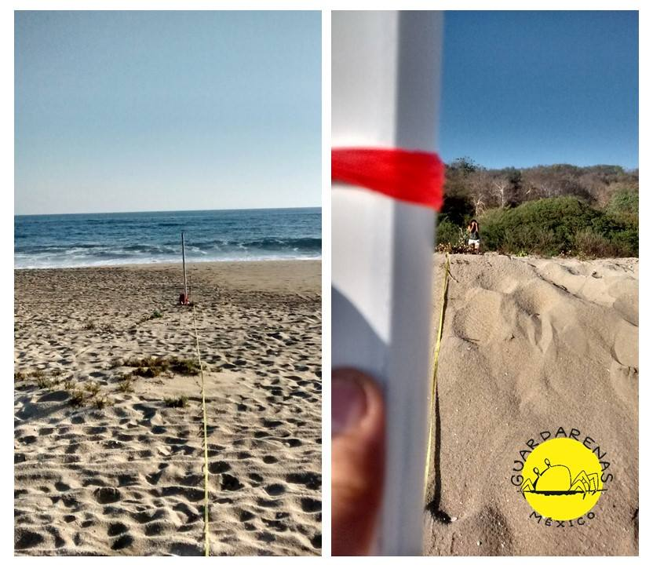
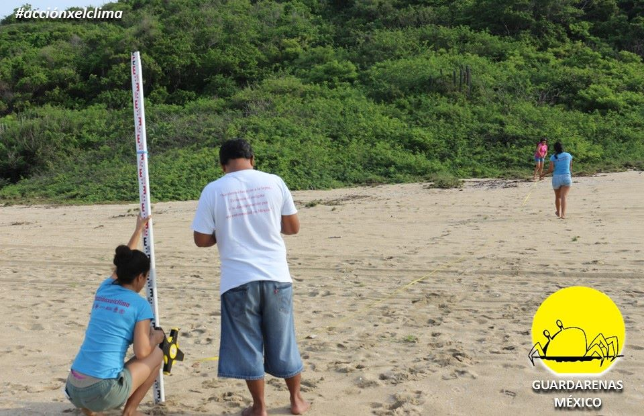
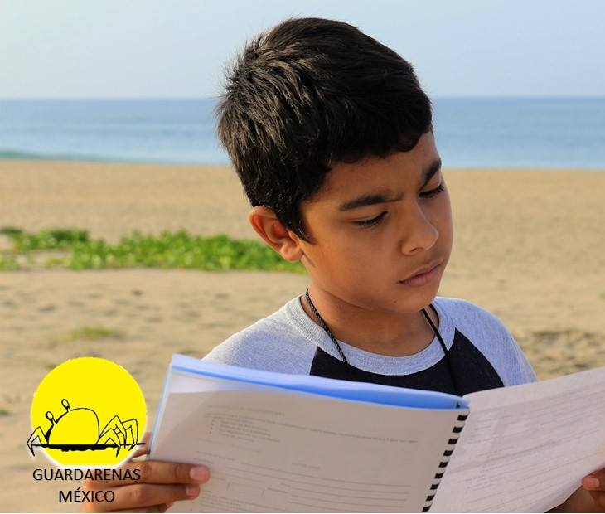
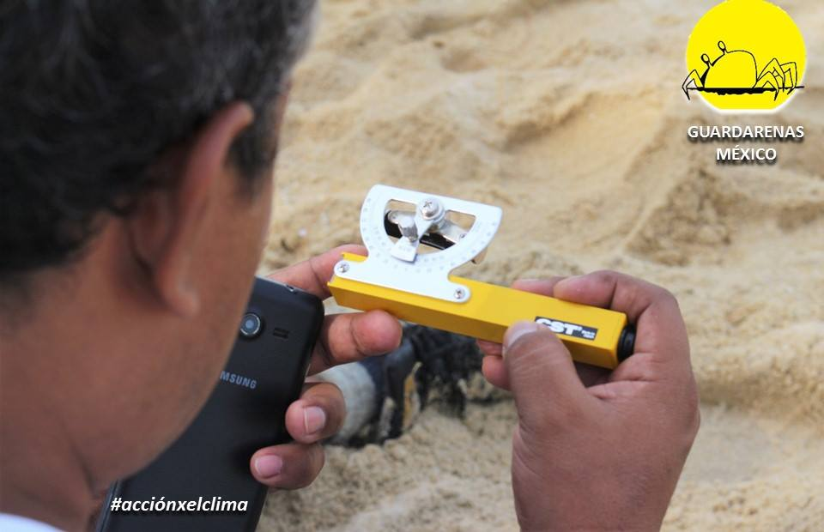
BACOCHO
3-3

Slide 10
3-2

Slide 11
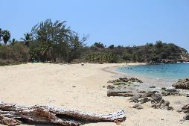
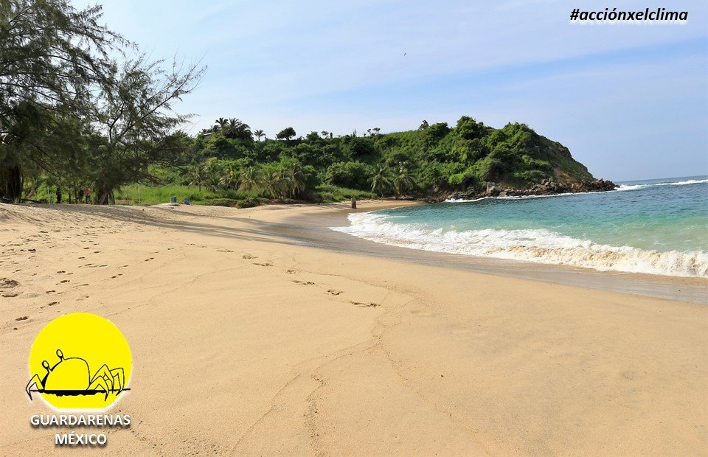
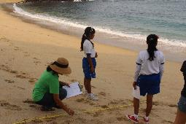
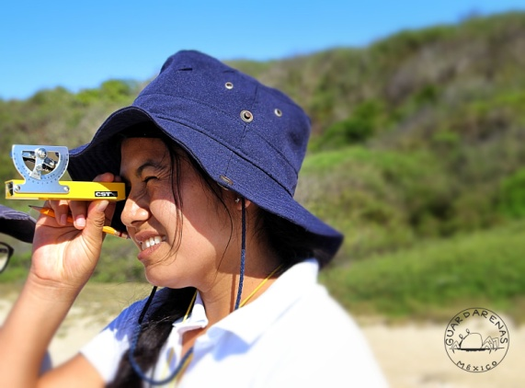
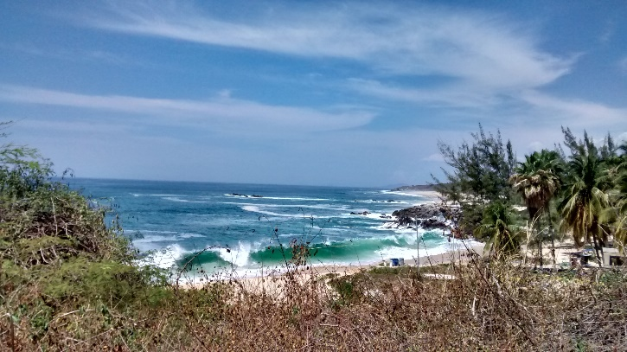
Playa Coral
WANT BIG IMPACT?
Use big image.
3-3

Slide 12
3-4

Slide 13
4. Statistics of participation
4-1

Slide 14
Operative Plan 2017-2018
Continuity of Monitorig
Schools trained for monitoring
Care and shelter of equipment
Acquiring more equipment
Strengthening of volunteer program
Complementary Activities
Accompaniment quarterly
Environmental education- each monitorig
Systematization
Training for using database
Analysing y taking accion
Local scale- community

Slide 15
